Slide 1

Presenting Findings
CSI08103
Information Interactions

Slide 2

Module Evaluation
Found in your email
Please spend a few minutes providing some feedback on the module
What should be included that isn’t, What didn’t work, What should continue

Slide 3

Content
Coursework Breakdown
Structure
Presenting Findings
Reflection

Slide 4
CW2 Breakdown Part A
What you planned
What you did - why
What did you find
What does this mean
Link to Metrics – what you set out to measure
Link to Model – Does the model support what you found OR does what you found relate to the chosen model

Slide 5
CW2 Breakdown Part B
Using your experiences through the diaries and what you’ve learned about Information Literacy
Using your experiences from the diaries AND of collecting/analysing data
Reflect on your experiences in terms of your own
Information Literacy
Data Literacy
Thinking about how your work meets established criteria; analyse the effectiveness of your efforts, and plan for improvement – feeding forward

Slide 6
Structure
Title page (including the module number and name, report title, your matriculation number, report word count)
Contents page (professionally formatted using the automatic ‘Table of Contents’ feature in the ‘References’ tab of Microsoft Word)
Introduction - (200-300 words) giving outline of the report structure.
Part 1 (1000-1250 words)
Brief outline of evaluation technique(s)
Presentation of findings
Discussion
Part 2 (750-1000 words)
Critique and reflection of Diary entries and Data Analysis activities
Summary – (200/300 words) - a summary of the main points from your report and an overall conclusion with reference to the original report objectives.
References - a list of the published sources cited in your report accurately and consistently presented in APA or Harvard format. This should include a range of published sources (including the Module texts from the reading list and articles obtained in your own research). Your references must be cited in the main body of the report (at appropriate points) to support your critical discussion.
Appendices – presenting screenshots, raw data, data analysis workings

Slide 7
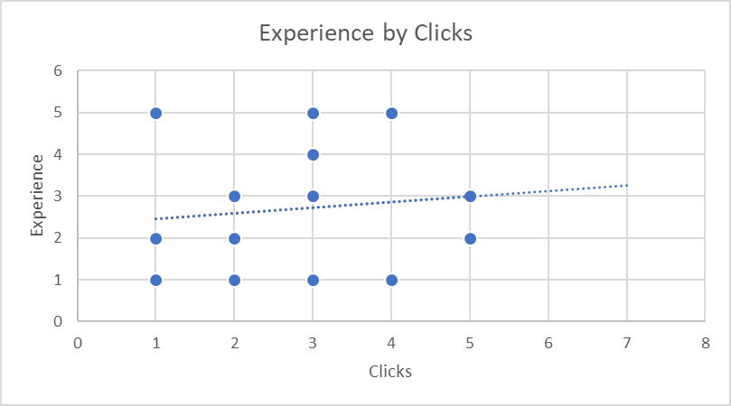
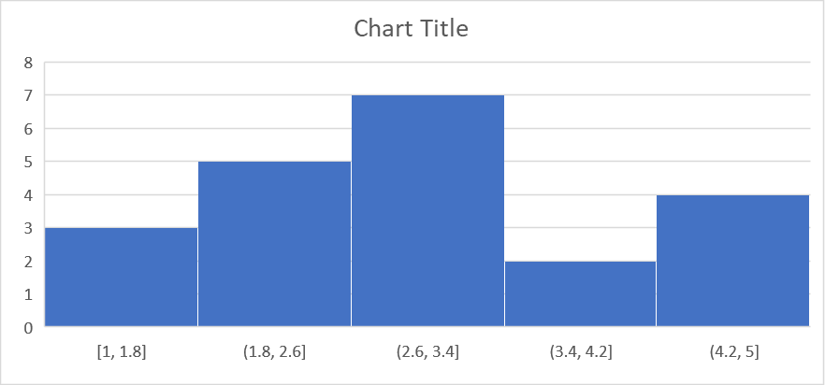
Presenting Findings
ID | Date | Times Clicked | Experience | Thoughts
1 | 11/02/22 | 2 | 1 | Good
2 | 11/02/22 | 3 | 1 | Great
3 | 11/02/22 | 5 | 2 | Great
4 | 11/02/22 | 5 | 2 | Great
5 | 11/02/22 | 3 | 3 | Bad
6 | 11/02/22 | 3 | 4 | Terrible

Slide 8
Presenting Findings
Explain what happened
“The study took part during one session in February 2022. This was a [INSERT Study and data collection approach]. Six participant’s took part in this experiment (see Table 1).
Following observations of their interactions the participants clicked on average….”
ID | Date | Times Clicked | Experience | Thoughts
1 | 11/02/22 | 2 | 1 | Good
2 | 11/02/22 | 3 | 1 | Great
3 | 11/02/22 | 5 | 2 | Great
4 | 11/02/22 | 5 | 2 | Great
5 | 11/02/22 | 3 | 3 | Bad
6 | 11/02/22 | 3 | 4 | Terrible
Table 1. Table of participant interactions, experience and thoughts

Slide 9
Presenting Findings
Times Clicked |  | Experience
Mean | 2.4 | Mean | 2.4
Standard Error | 0.678233 | Standard Error | 0.509902
Median | 2 | Median | 2
Mode | 1 | Mode | 2
Standard Deviation | 1.516575 | Standard Deviation | 1.140175
Explain what happened
“…..
Following observations of their interactions the participants clicked on average 2.4 times (Table 1). Due to the distribution of data (see Figure 1). ”
Table 2. Table of participant interactions and experience
Figure 1. Histogram of Times Clicked

Slide 10

Synthesis
Make sure the findings are linked back to the selected metrics.
Compare the findings to the model selected.
Did you find that thoughts or actions link to aspects of the model – explain this and use your findings to evidence it.
Use citations e.g.
“As seen in figure 1, the findings support the theory that participants emotional response is directly linked to their efforts. This confirms what Pirolli & Card (1996) discuss in their theory of information foraging.”

Slide 11
Reflection
Reflecting - looking back over what you’ve read, observed, felt and experienced - helps you process and store information for future use. Reflection can help you recognise the links between theories, concepts and events and, therefore, help you to understand their significance and relevance.
Looking back objectively and examining your actions, thoughts and behaviours helps you become a more effective learner: someone who continues to develop and improve.

Slide 12


Slide 13
Module Evaluation
Found in your email
Please spend a few minutes providing some feedback

Slide 14
Recommended Reading
https://my.napier.ac.uk/your-studies/improve-your-academic-and-study-skills/study-sheets

